Slide 1
Live Video Streaming and Chat Web Application using Google Docker and Kubernetes
By
Bhanu Dobriyal
Tejesh Agrawal
Kasturi Vartak
CS580K - Cloud Computing Big Project

Slide 2
Topics
Abstract
Motivation
Web Interface
Docker
Autoscaling
Demo
Challenges
Future Scope
Links

Slide 3
Abstract
Created a Web Application with live Video and Chat features among users
Build the Docker Image for the single container containing this app
Uploaded this Image to Docker Hub
Created cluster using Kubernetes cluster manager
Deployed the containerized application over Kubernetes cluster
Autoscaling the app using Kubernetes

Slide 4
Motivation
Live streaming video and chat feature
Users can share a live video streaming and others can discuss about it over chat
Similar to various live video streaming by Youtube , Facebook and Instagram
Large user base and live streaming needs robust platform to orchestrate traffic
Global video streaming market is 42.6 billion USD as of 2019
Kubernetes
Use Kubernetes deployments to deploy pod workloads
Allow applications to automatically respond to changes in their workloads and scale to meet demand

Slide 5
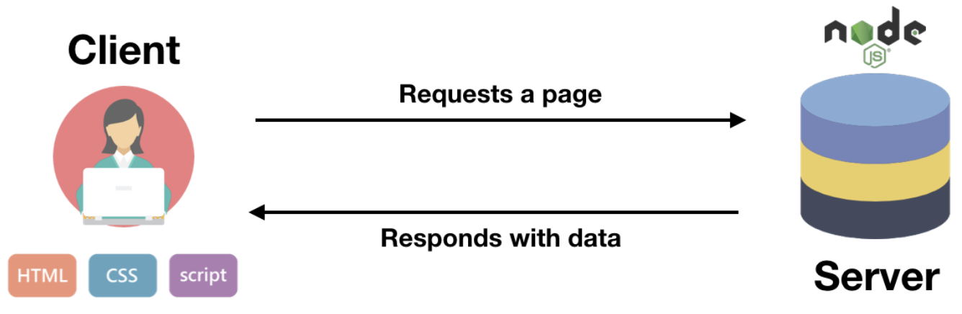
Web Interface
Technical stack used for this app
Ejs - template engine to simplify production of HTML
Websockets - Protocol that allows bilateral synchronous exchange between client and server. Socket.io is the library used.
Express.js - Framework based on Node.js which is JS back-end tech executed by server.
CSS - For user interface template design and stylesheets.

Slide 6
Docker
We created a docker image and uploaded it on hubs.docker.com
As we have docker image, it can be run on any cloud platform.
We created file named as Dockerfile into current code directory.
And build the image using Dockerfile.
Size of docker image is around ~80 MB.
Docker hub link:
docker pull waaft/waaft:3.0.0

Slide 7
Horizontal Pod Autoscaling

Slide 8
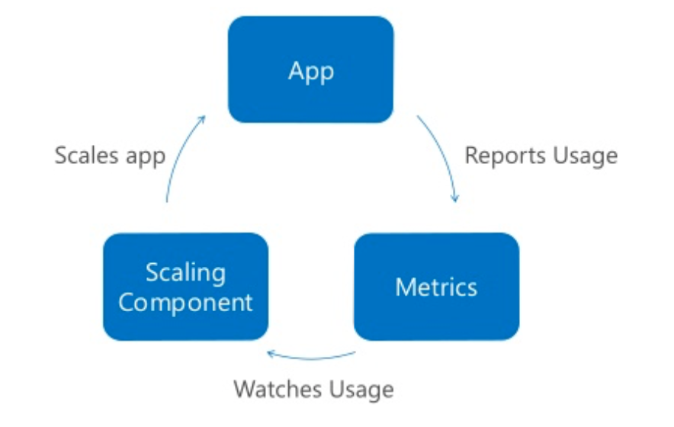
Things we need for scaling

Slide 9
Kubernetes Manifest:
YAML files to declare desired state of Kubernetes object types.
Create YAML to run the project.
to run deployment of the application
to run service for the application
for Horizontal Pod Autoscaling

Slide 10
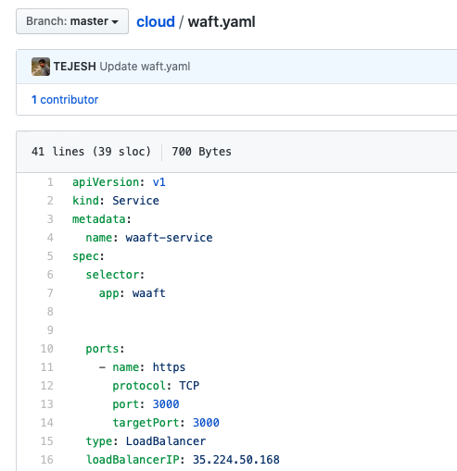
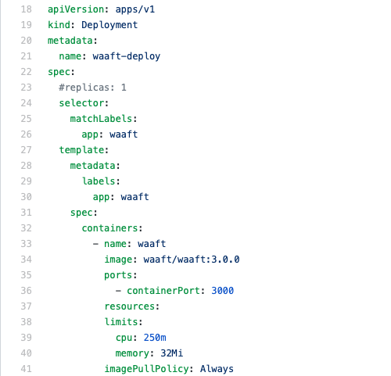

Slide 11
Submit the deployment and service manifests to the cluster with kubectl:
kubectl apply -f deployment.yaml
kubectl apply -f service.yaml
Best for distributing and separate services, for deployment purpose.
Or
kubectl apply -f waft.yaml
This one has both included, better for testing purpose.

Slide 12
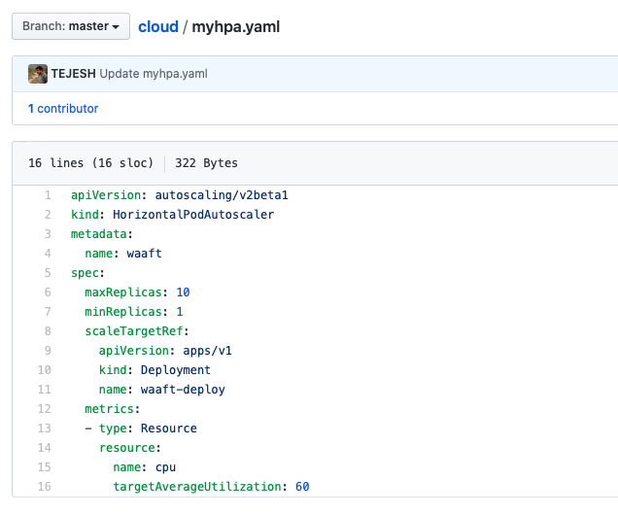
Creating an HPA
Create the autoscaler with kubectl:
kubectl apply -f myhpa.yaml

Slide 13
Provide more or less processing power for an application
CPU utilization above 60% add replicas
CPU utilization below 60% scale down replicas
(replicas: between 1 to 10 inclusive)

Slide 14
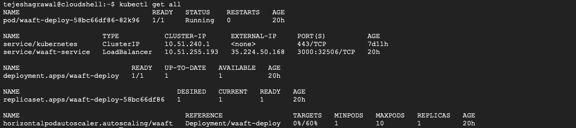
Current state of HPA with kubectl after HPA creation:

Slide 15
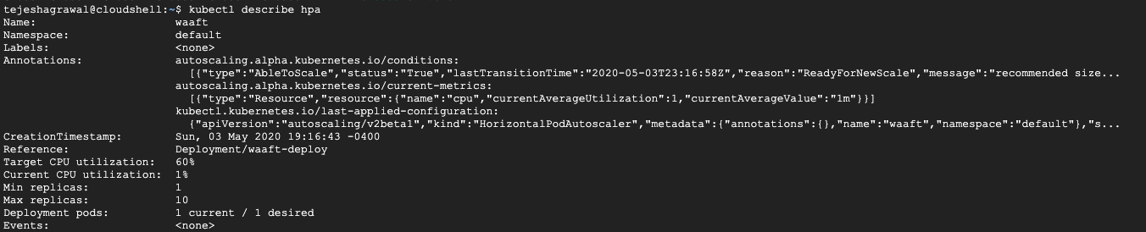

Slide 16

Waaft - Demo
http://35.224.50.168:3000/

Slide 17
Challenges
Instead of Youtube API live streaming, we decided to go and study ffmpeg for camera access, libx24 to encode the live camera video to a format (.avi) video to display on browser, because the video will be hosted on youtube platform, but later we decided to move to WebRTC.
Instead of nginx, we are currently hosting application on Kubernetes.Before this we hosted the application directly on GCP app engine, but it is consumes GCP credits very fast. So we moved it to Kubernetes cluster and autoscaled it base on CPU utilization.
Challenges while integrating the Chat and Video features of the application

Slide 18
Future Scope
Https, to access camera on browser, we have to create SSL certificates, for now a user has to manually enable connection for a given url to enable camera through browser.
Login and Signup pages for authenticating users accessing the feeds. MongoDB connectivity to store this information at backend.
We will introduce Nginx as well, so that different images such as mongoDB and application docker image can be combined and hosted on single url.

Slide 19
Links and References
Static Link: http://35.224.50.168:3000/
WebRTC: https://webrtc.org
Kubernetes: https://learnk8s.io/nodejs-kubernetes-guide
Autoscaling: https://hub.packtpub.com/implementing-horizontal-pod-autoscaling-in-kubernetes-tutorial/

Slide 20
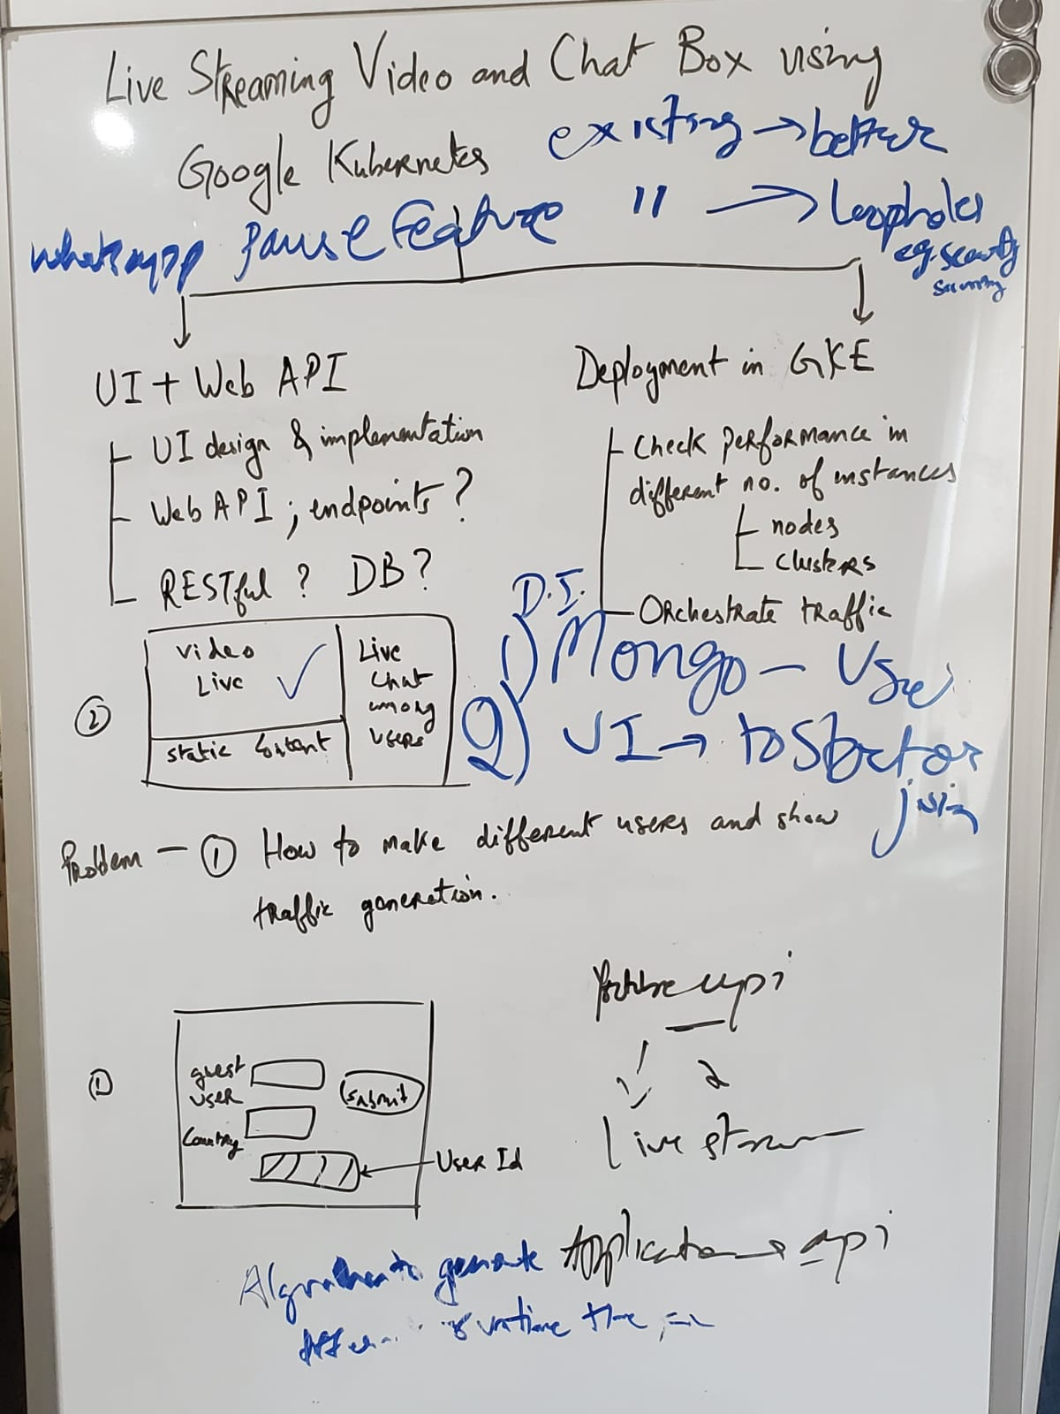
Thankyou!!

